Slide 1
Yell (Scream against crime)
Tisha Khandokar
Id : 192-35-459

Slide 2

Yell is an inquiry messenger team. And also an investigation research department based on Cyber crime. In the Bangladesh and all over the world its rare view to see instant step for the bullying or harassment. Our motto:”Scream against crime”

Slide 3
Overview
Background
Objectives
Scope
Assumptions and Constraints
Dependencies and Risks

Slide 4

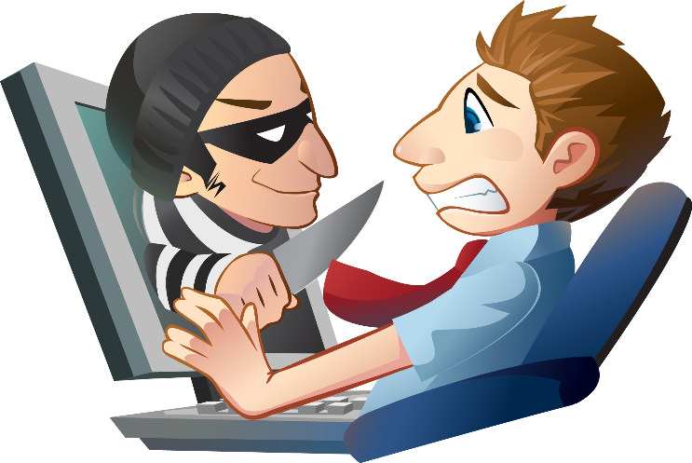
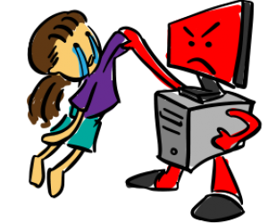

Background
Cyber Bullying
Cyber Threat
Cyber Harassment
Cyber Stalking

Slide 5
Objectives
Yell
Victim
Admin
C.bullying C.harrassement C.blackmail C.threat
Information
Solution
Submit to Admin Panel
Law panel

Slide 6
Scope
In there has two panel- -One is public user/victims that inform about crime issue.
It means the victims are public user.
-Admin panel take the case with full of information and verification. -Then the information transferred to security or law system . And also other sections are build up by yell. like: -Blogging on Cyber crime issue for awareness. -Video for bullying, harassment.

Slide 7
Assumptions and Constraints
-Comfortable with computer.
-Must have good knowledge on web surfing.
-The cyber crime department should have proper knowledge.
-must have proper English knowledge.

Slide 8
Dependencies and Risks
The user must have web access in order to use the system. The main risk behind implementing the project is security. If somebody hacks the system then it will be a total disorder. So during development it will be one of our major concerns. Another concern is building the department of cyber security panel

Slide 9
Reference
link: https://www.cybercrimelaw.net/Bangladesh.html https://www.dhakatribune.com/opinion/2018/09/02/ict-laws-which-work#
That’s for TODAY!
Thank You

